Slide 1
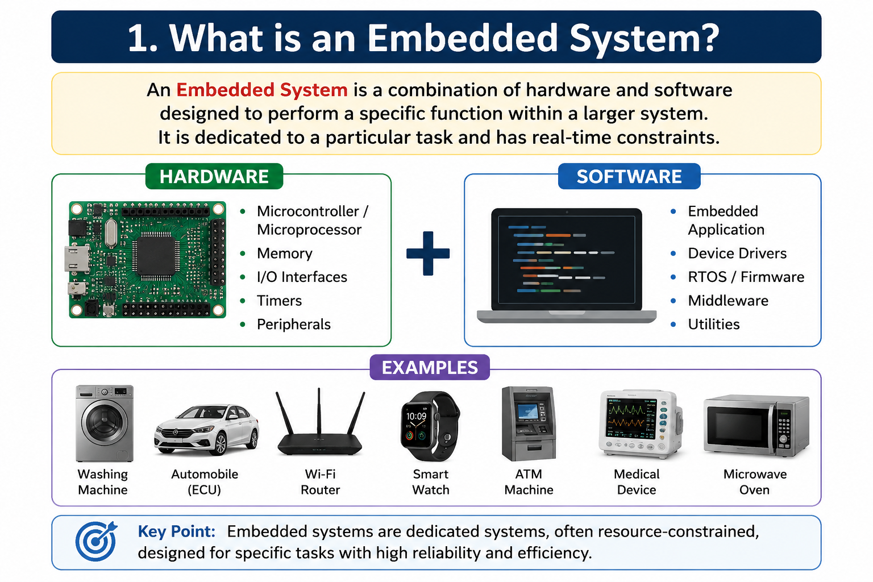
Contact for learning Cracking Embedded System Interviews
+91 7569883386
vintechembeddedacademy@gmail.com

Slide 2
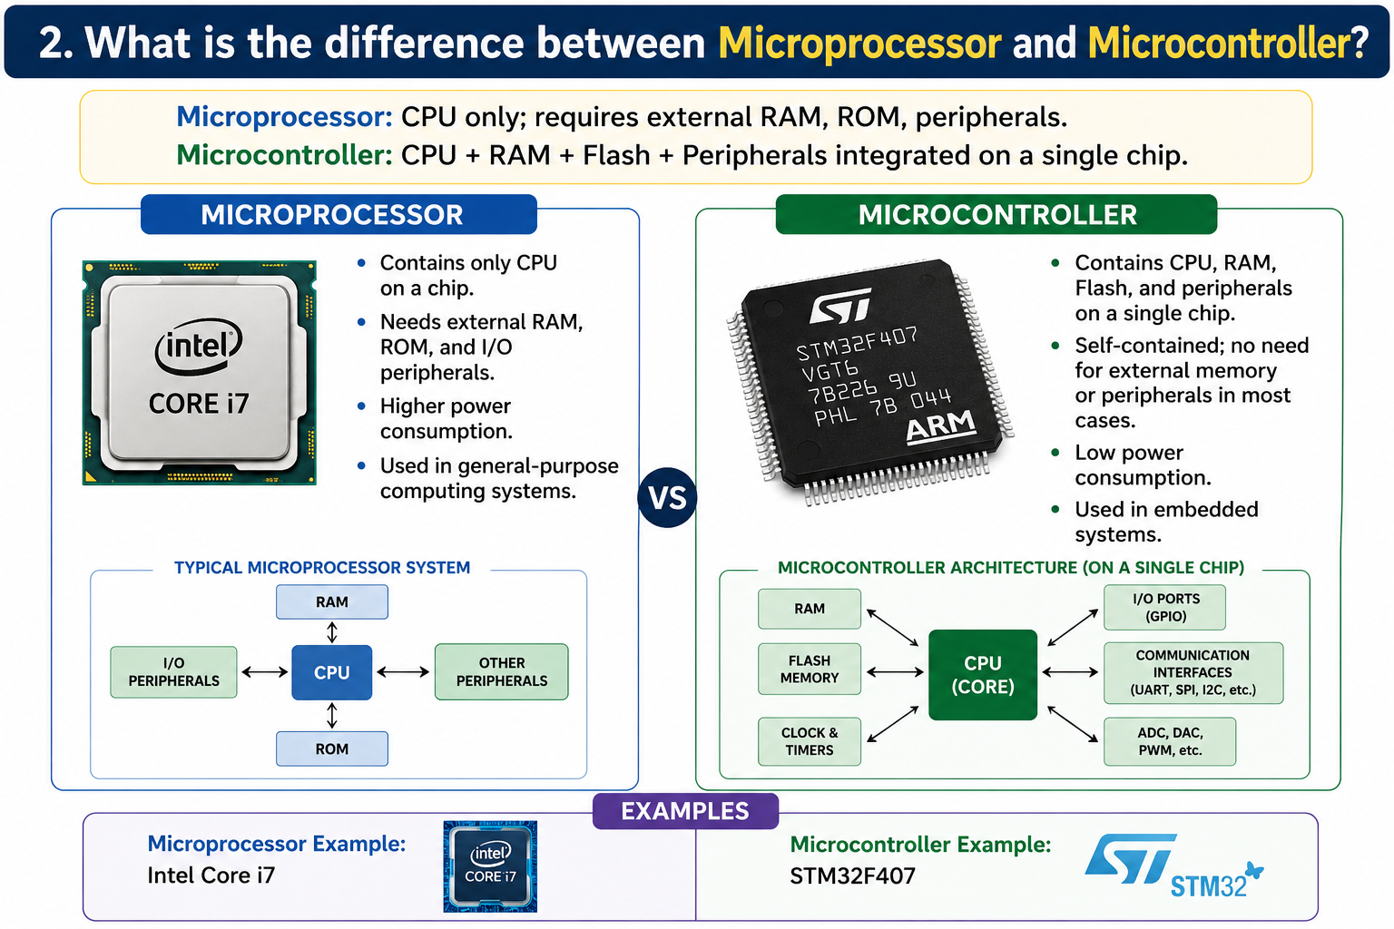
Contact for learning Cracking Embedded System Interviews
+91 7569883386
vintechembeddedacademy@gmail.com

Slide 3

Contact for learning Cracking Embedded System Interviews
+91 7569883386
vintechembeddedacademy@gmail.com

Slide 4

Contact for learning Cracking Embedded System Interviews
+91 7569883386
vintechembeddedacademy@gmail.com

Slide 5
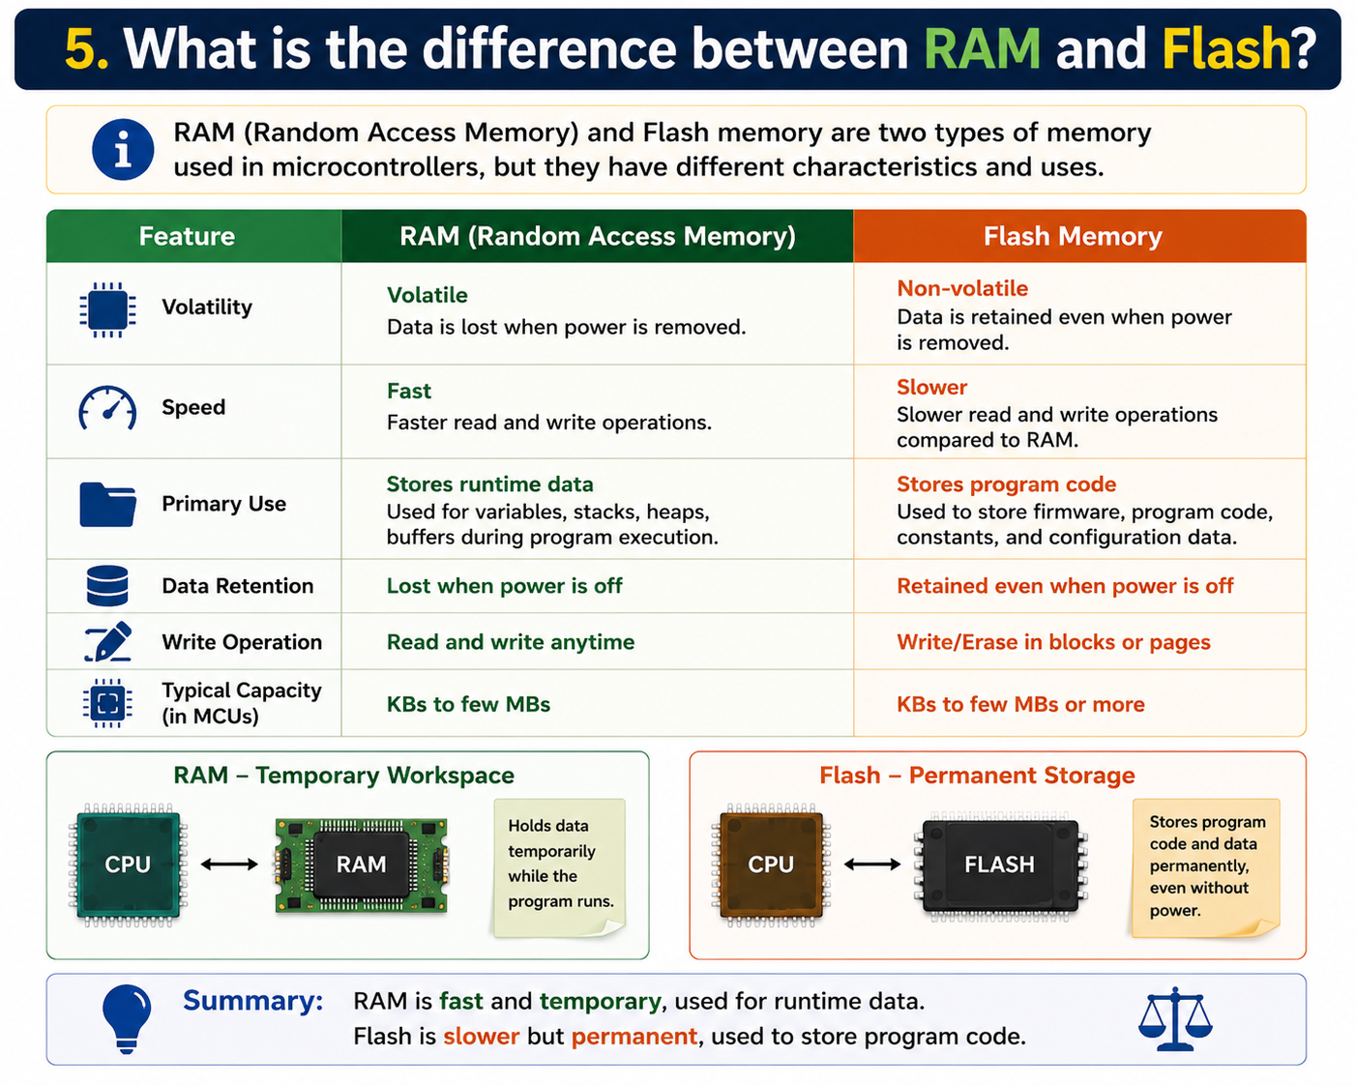
Contact for learning Cracking Embedded System Interviews
+91 7569883386
vintechembeddedacademy@gmail.com

Slide 6
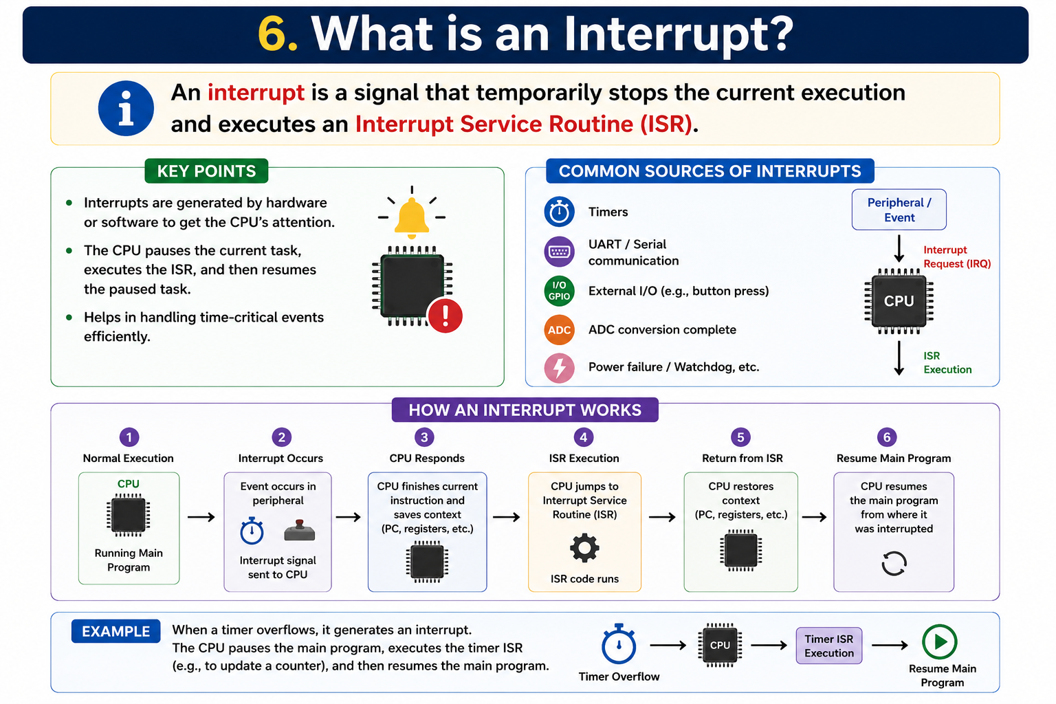
Contact for learning Cracking Embedded System Interviews
+91 7569883386
vintechembeddedacademy@gmail.com

Slide 7
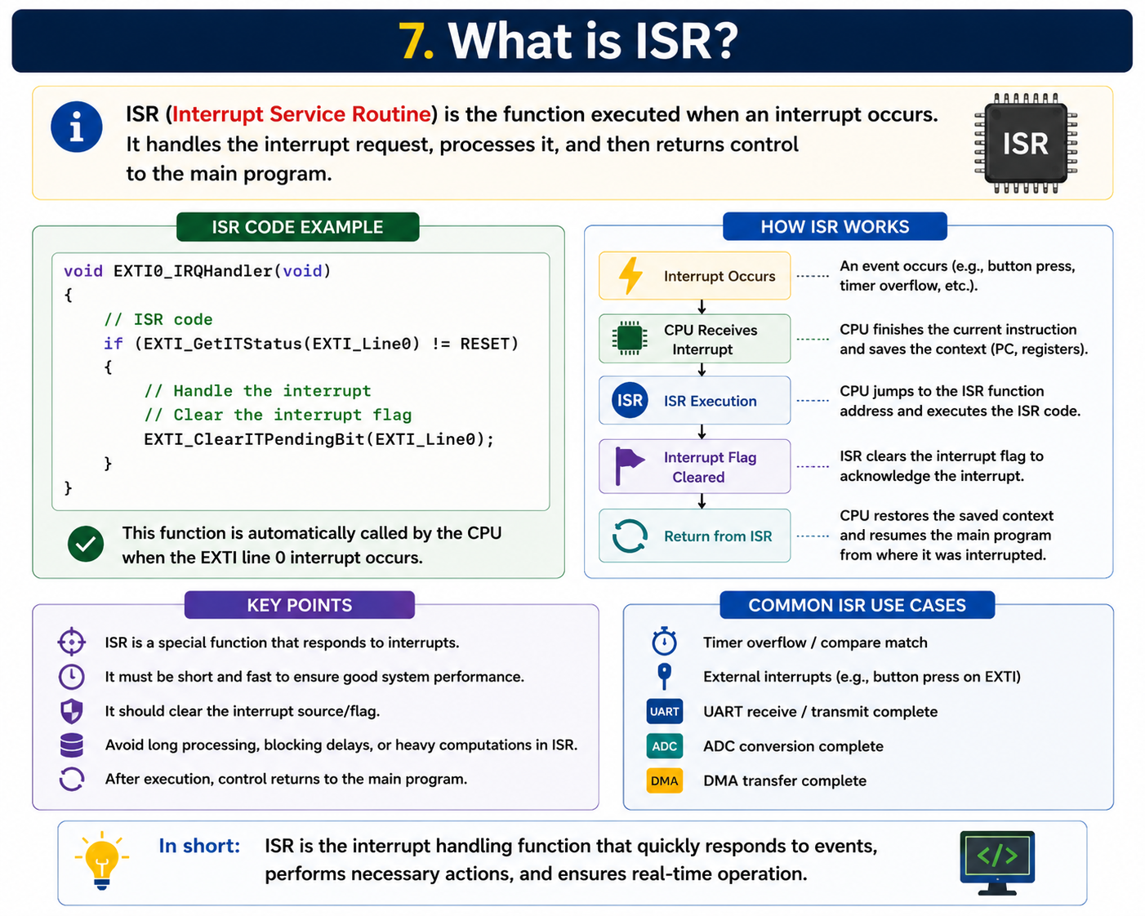
Contact for learning Cracking Embedded System Interviews
+91 7569883386
vintechembeddedacademy@gmail.com

Slide 8
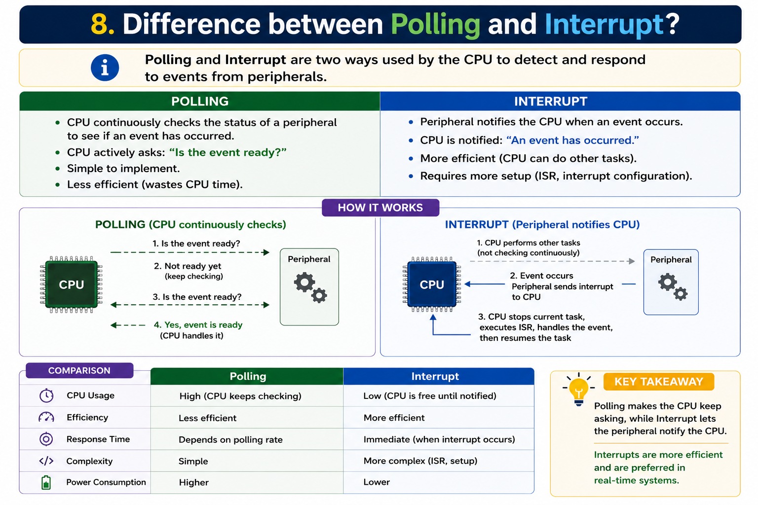
Contact for learning Cracking Embedded System Interviews
+91 7569883386
vintechembeddedacademy@gmail.com

Slide 9

Contact for learning Cracking Embedded System Interviews
+91 7569883386
vintechembeddedacademy@gmail.com

Slide 10

Contact for learning Cracking Embedded System Interviews
+91 7569883386
vintechembeddedacademy@gmail.com

Slide 11

Contact for learning Cracking Embedded System Interviews
+91 7569883386
vintechembeddedacademy@gmail.com

Slide 12
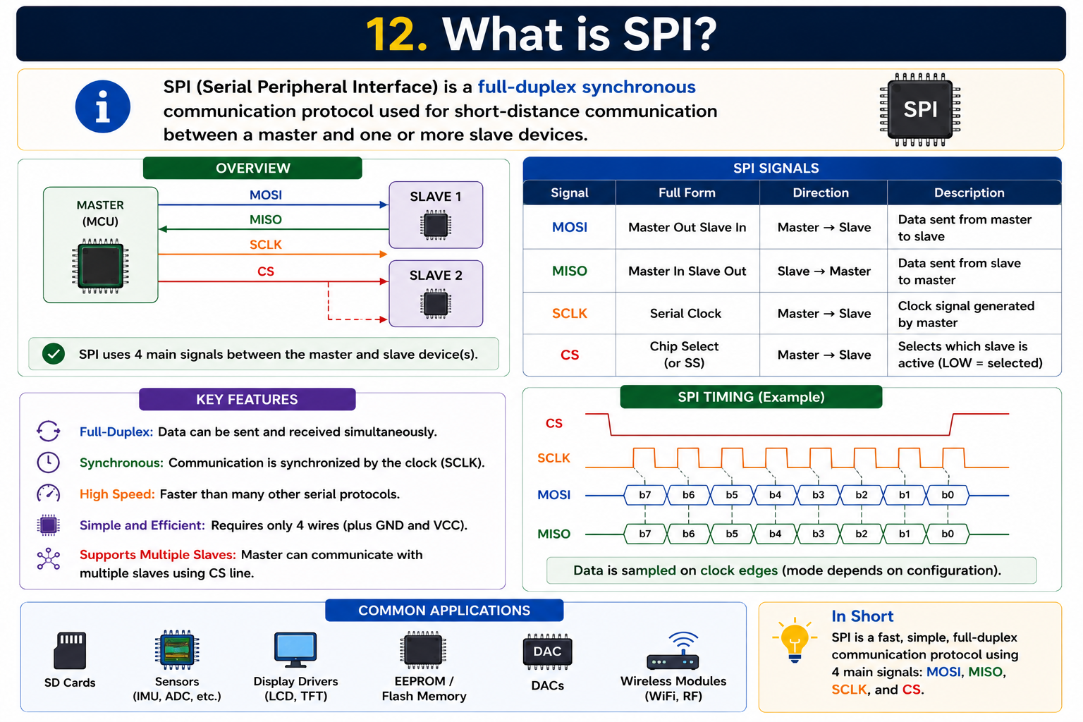
Contact for learning Cracking Embedded System Interviews
+91 7569883386
vintechembeddedacademy@gmail.com

Slide 13
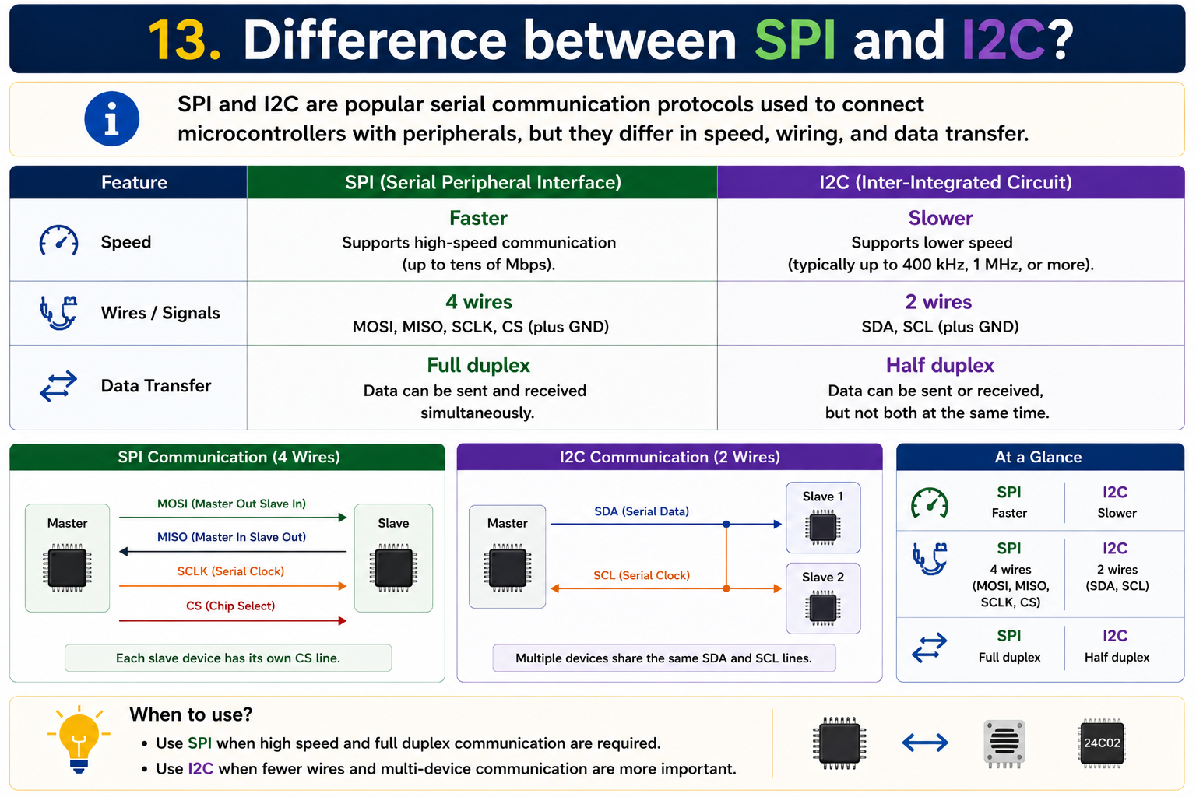
Contact for learning Cracking Embedded System Interviews
+91 7569883386
vintechembeddedacademy@gmail.com

Slide 14
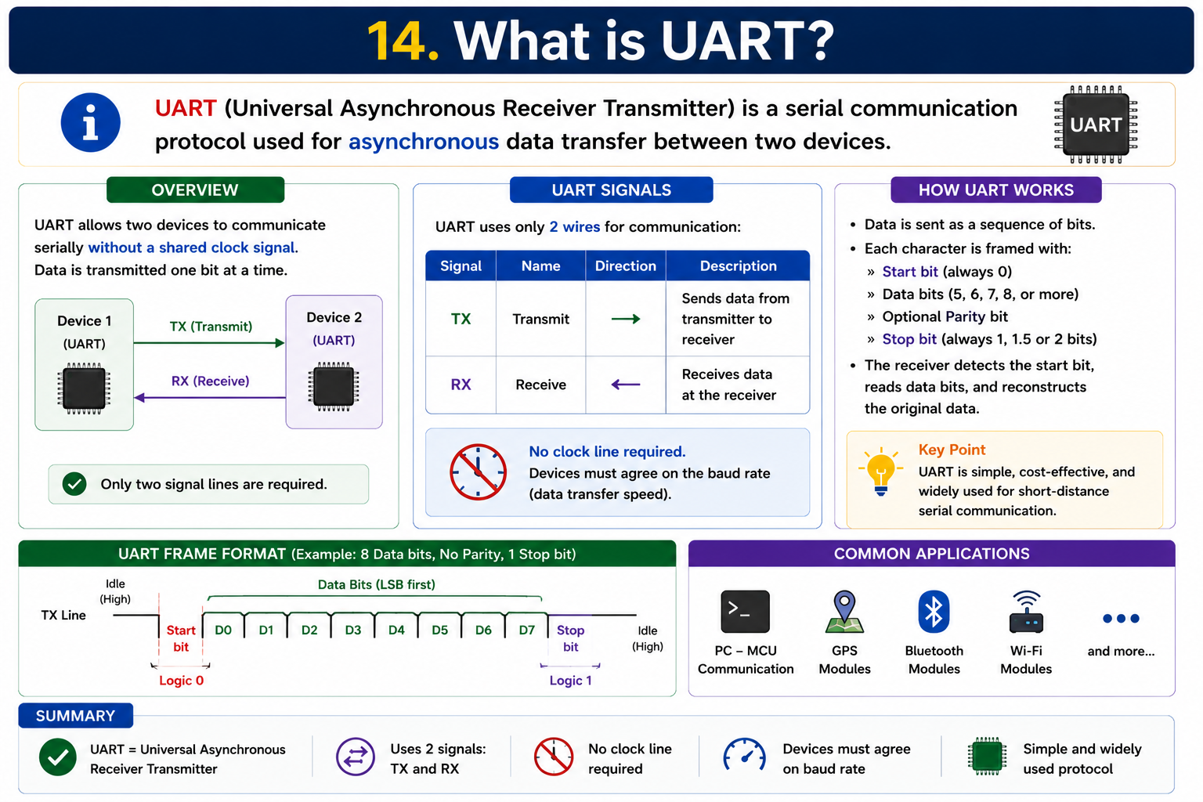
Contact for learning Cracking Embedded System Interviews
+91 7569883386
vintechembeddedacademy@gmail.com

Slide 15
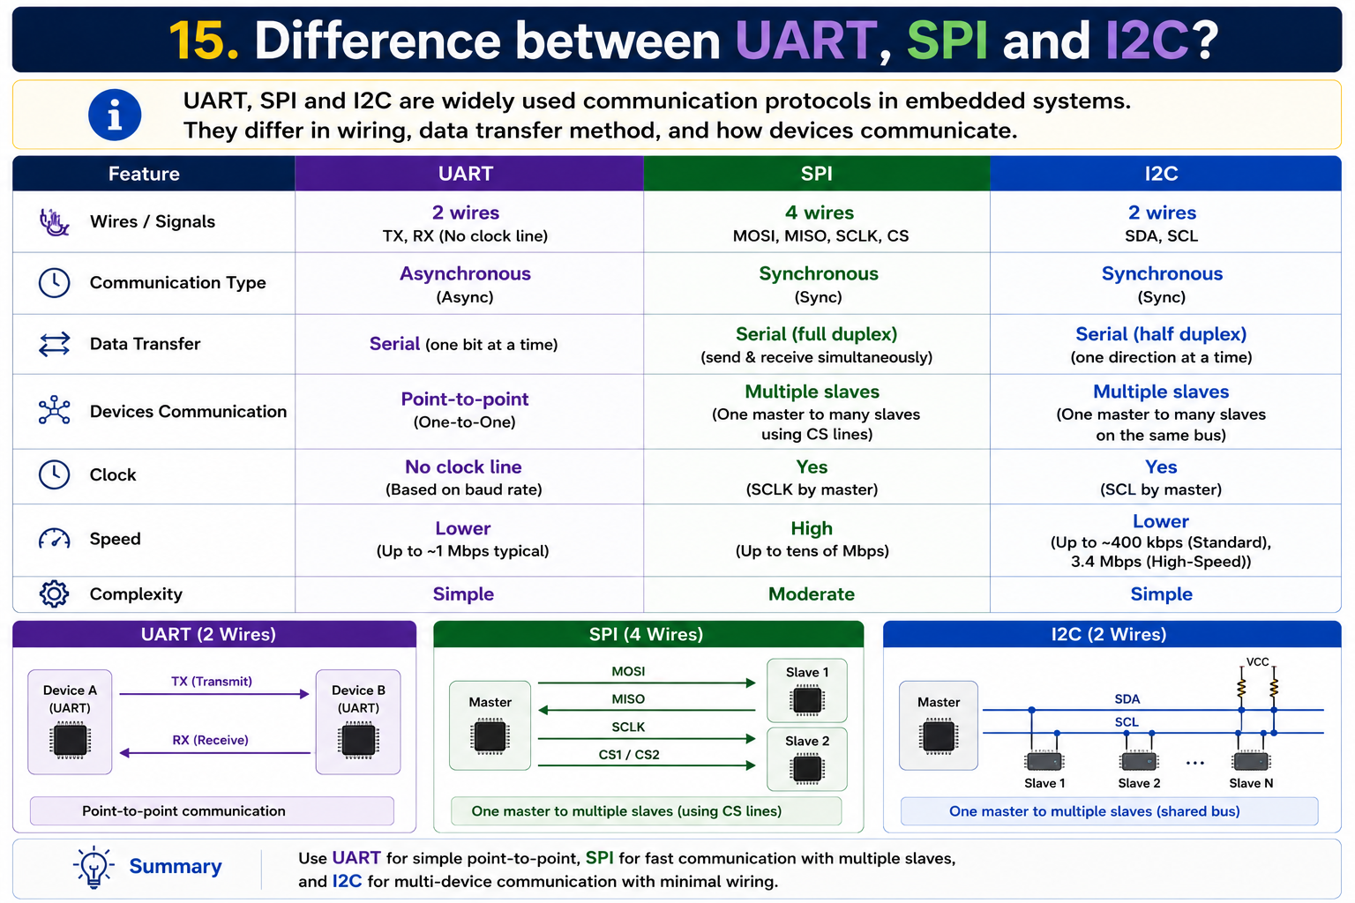
Contact for learning Cracking Embedded System Interviews
+91 7569883386
vintechembeddedacademy@gmail.com

Slide 16

Contact for learning Cracking Embedded System Interviews
+91 7569883386
vintechembeddedacademy@gmail.com

Slide 17
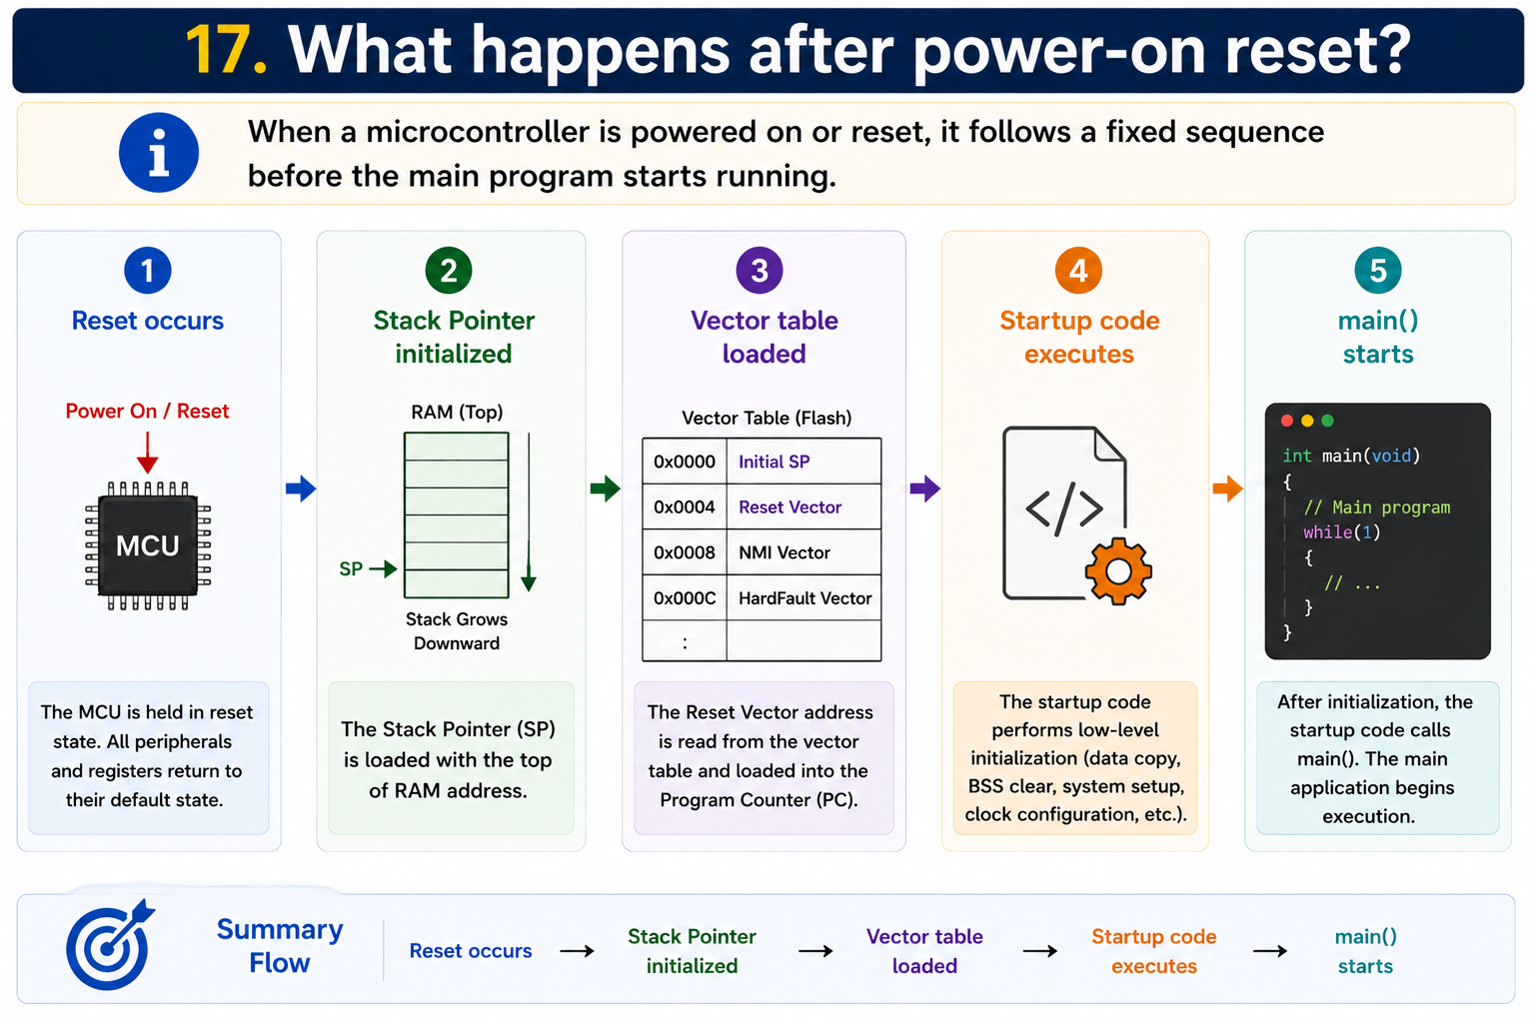
Contact for learning Cracking Embedded System Interviews
+91 7569883386
vintechembeddedacademy@gmail.com

Slide 18
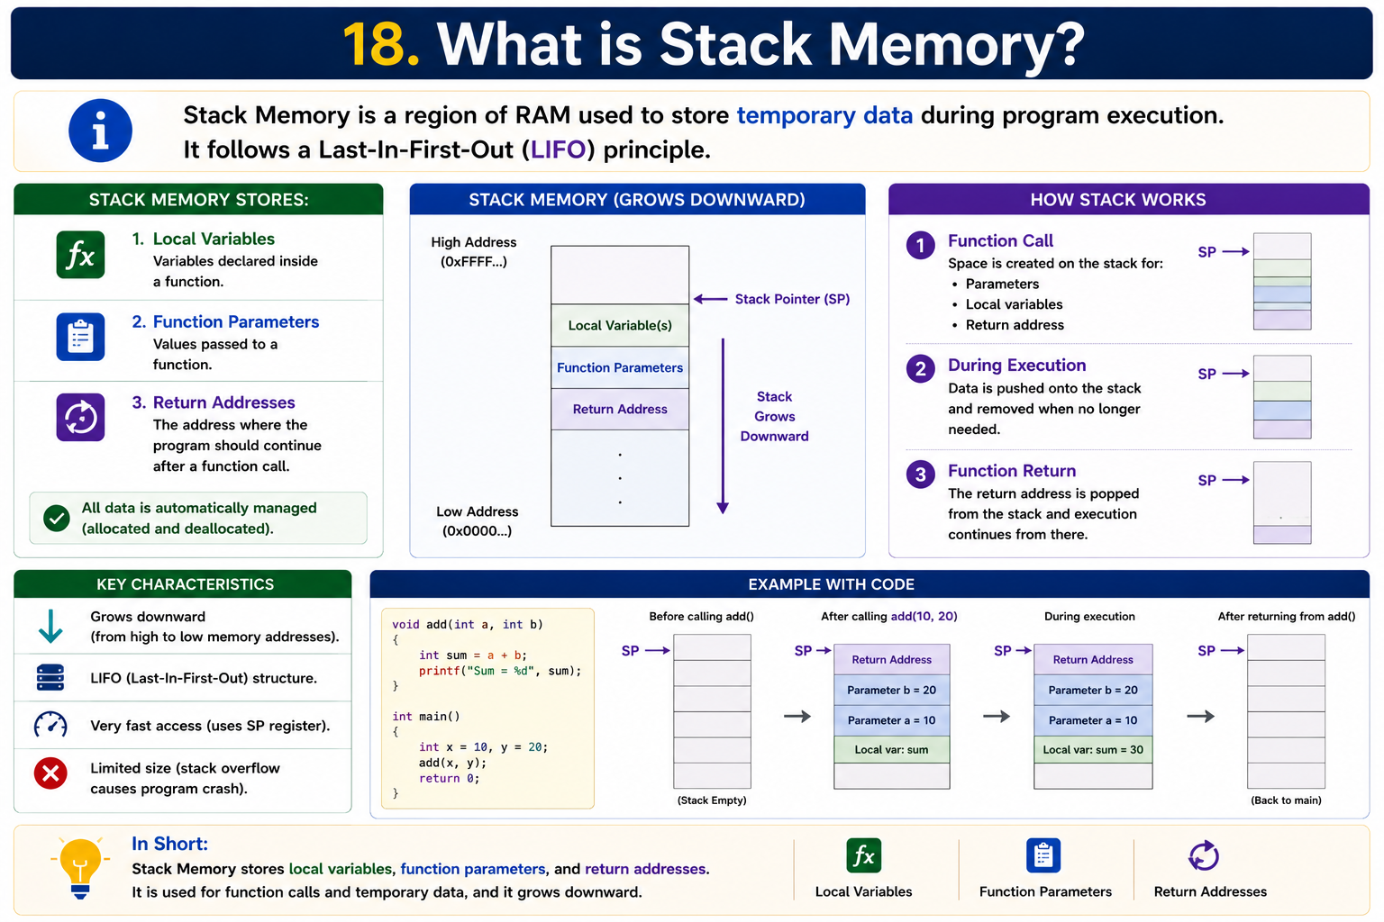
Contact for learning Cracking Embedded System Interviews
+91 7569883386
vintechembeddedacademy@gmail.com

Slide 19
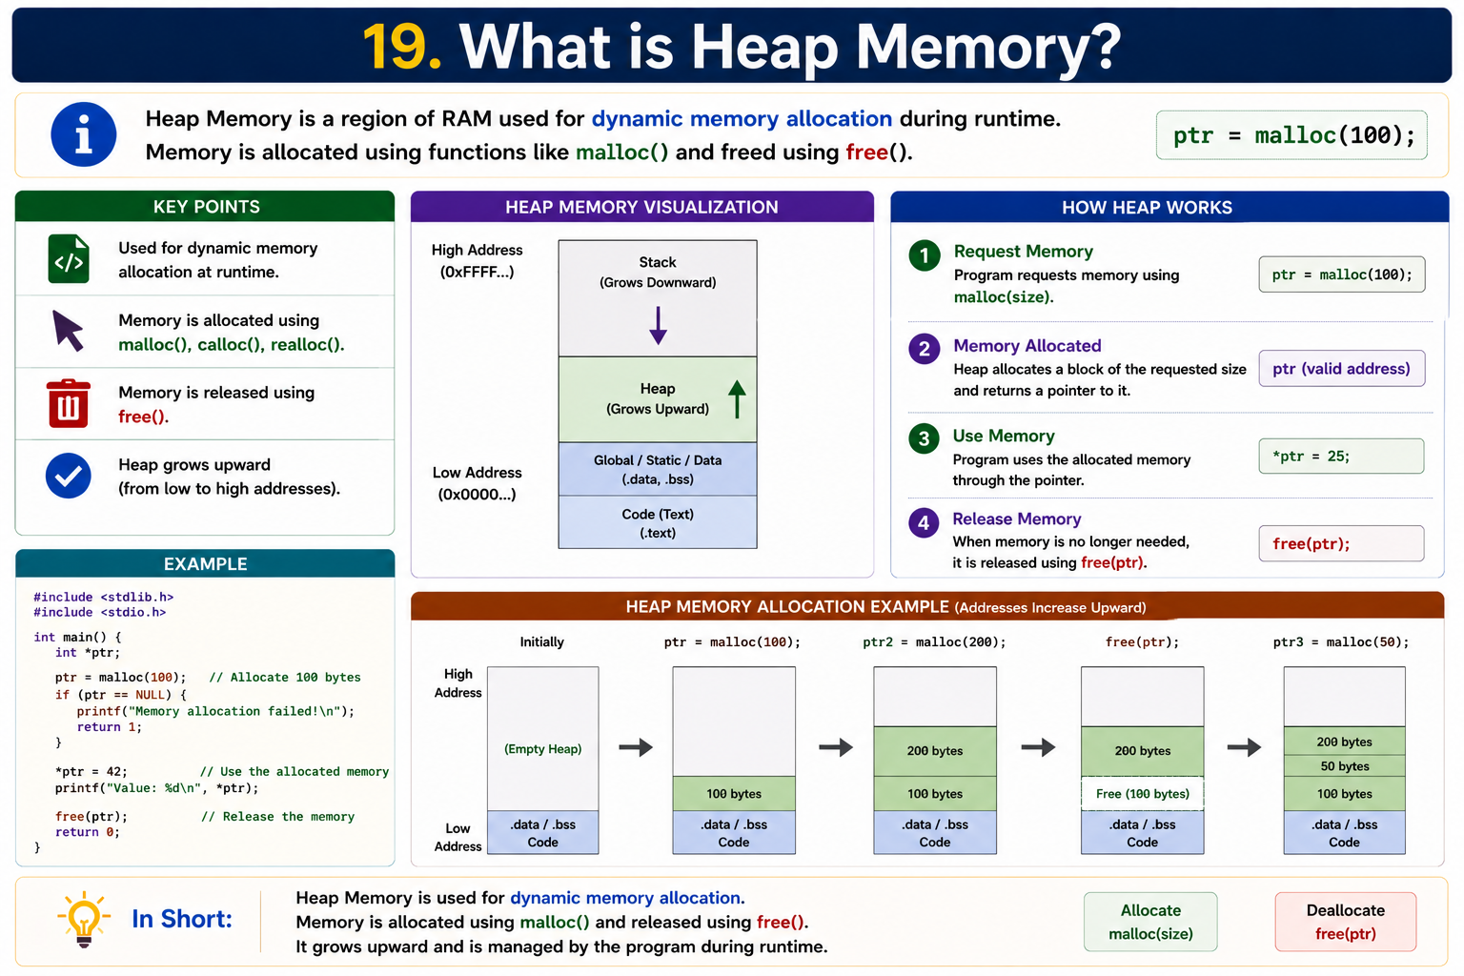
Contact for learning Cracking Embedded System Interviews
+91 7569883386
vintechembeddedacademy@gmail.com

Slide 20

Contact for learning Cracking Embedded System Interviews
+91 7569883386
vintechembeddedacademy@gmail.com

Slide 21
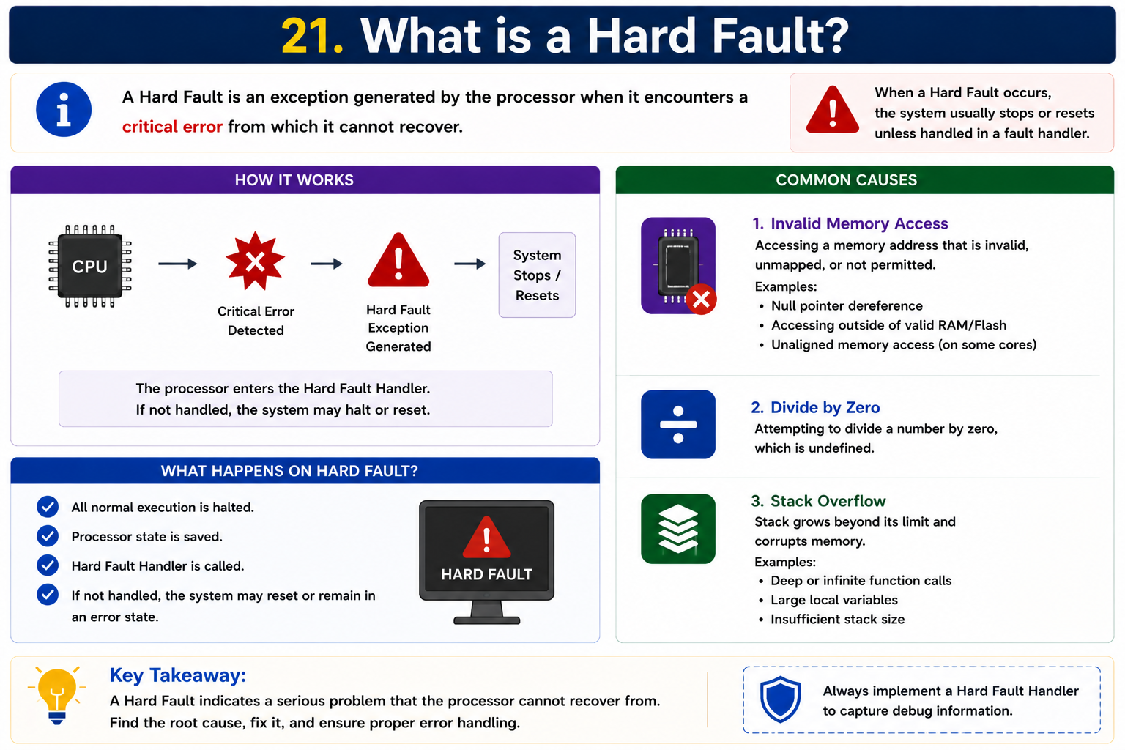
Contact for learning Cracking Embedded System Interviews
+91 7569883386
vintechembeddedacademy@gmail.com

Slide 22
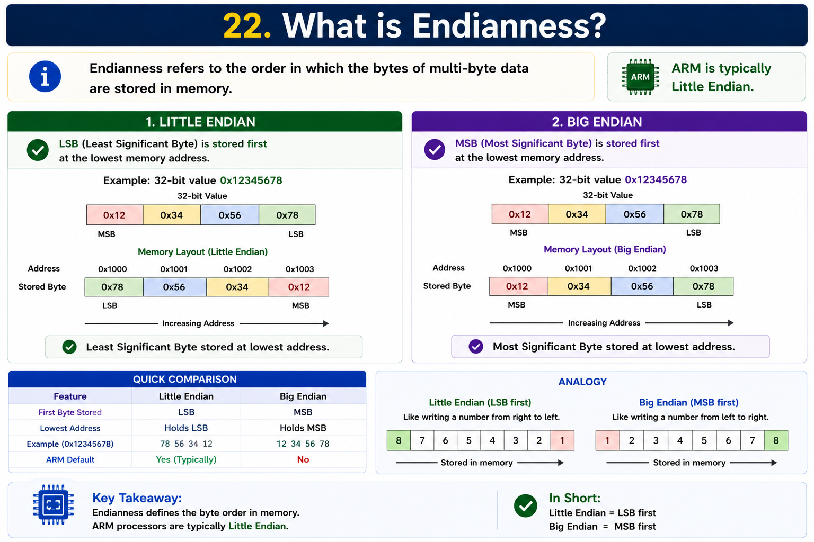
Contact for learning Cracking Embedded System Interviews
+91 7569883386
vintechembeddedacademy@gmail.com

Slide 23

Contact for learning Cracking Embedded System Interviews
+91 7569883386
vintechembeddedacademy@gmail.com

Slide 24
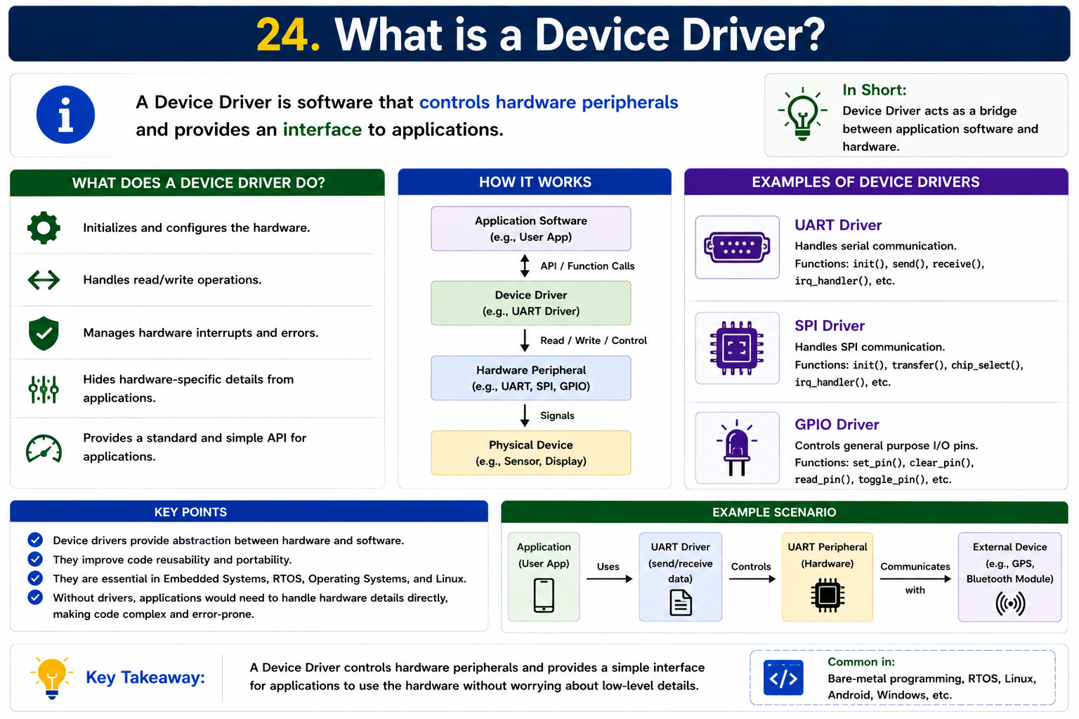
Contact for learning Cracking Embedded System Interviews
+91 7569883386
vintechembeddedacademy@gmail.com

Slide 25
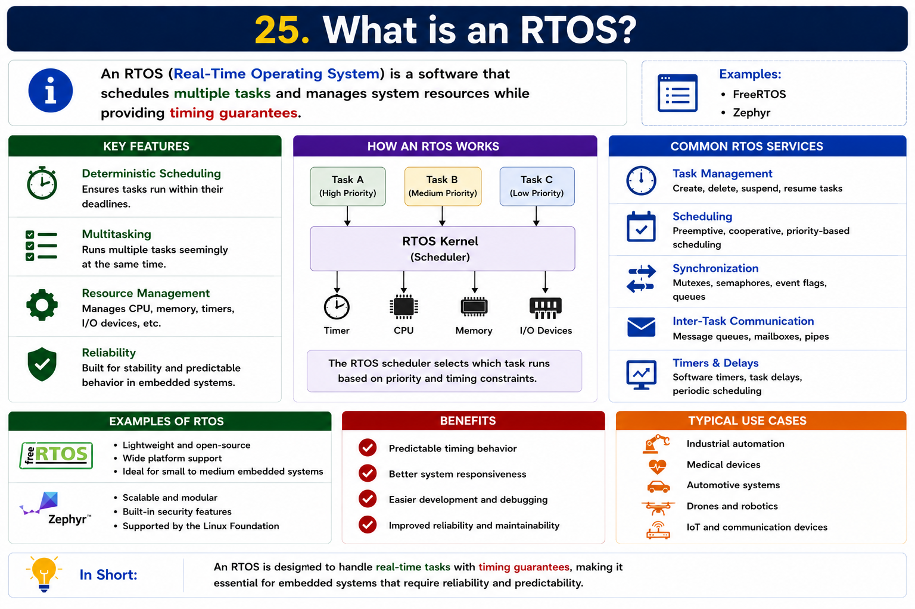
Contact for learning Cracking Embedded System Interviews
+91 7569883386
vintechembeddedacademy@gmail.com

Slide 26
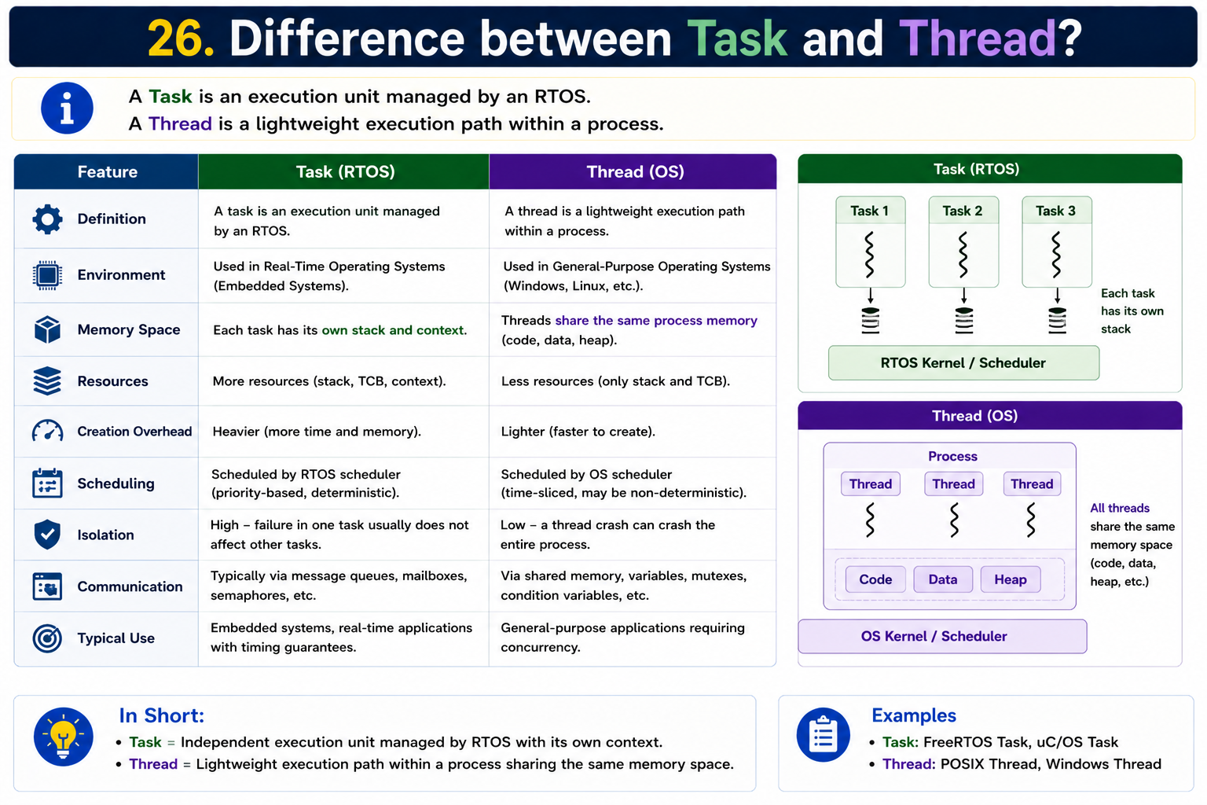
Contact for learning Cracking Embedded System Interviews
+91 7569883386
vintechembeddedacademy@gmail.com

Slide 27

Contact for learning Cracking Embedded System Interviews
+91 7569883386
vintechembeddedacademy@gmail.com

Slide 28
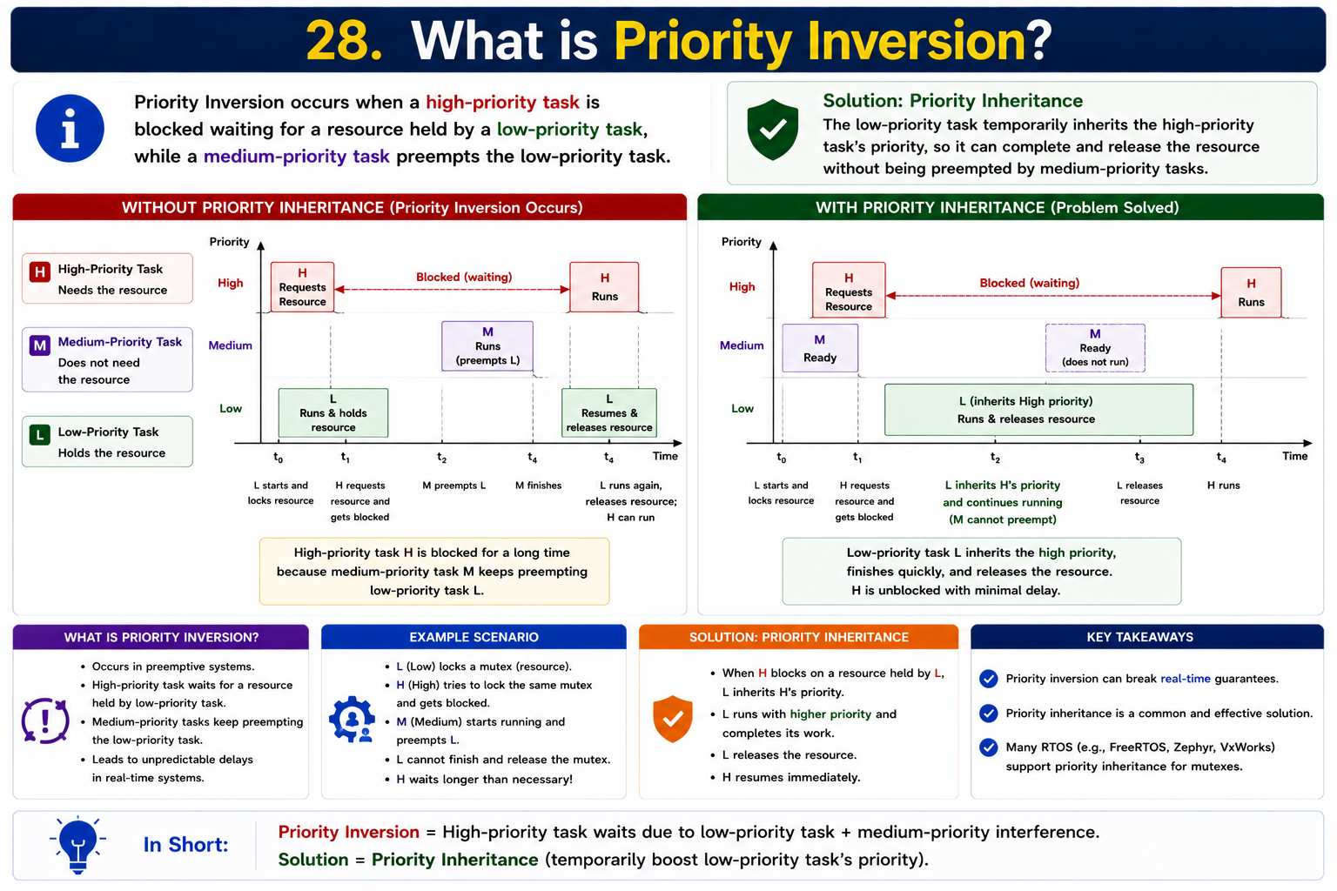
Contact for learning Cracking Embedded System Interviews
+91 7569883386
vintechembeddedacademy@gmail.com

Slide 29

Contact for learning Cracking Embedded System Interviews
+91 7569883386
vintechembeddedacademy@gmail.com

Slide 30


